Slide 1


Global Information Tracker

Slide 2
What Is Git?
Git is a version control system for tracking changes in computer files. It is generally used for source code management in software development.
Git is used to tracking changes in the source code
The distributed version control tool is used for source code management
It allows multiple developers to work together

Slide 3
What Is GitHub?
GitHub is a Git repository hosting service that provides a web-based graphical interface (GUI). It helps every team member work together on a project from anywhere, making it easy to collaborate.
GitHub helps all team members stay on the same page and stay organized.

Slide 4
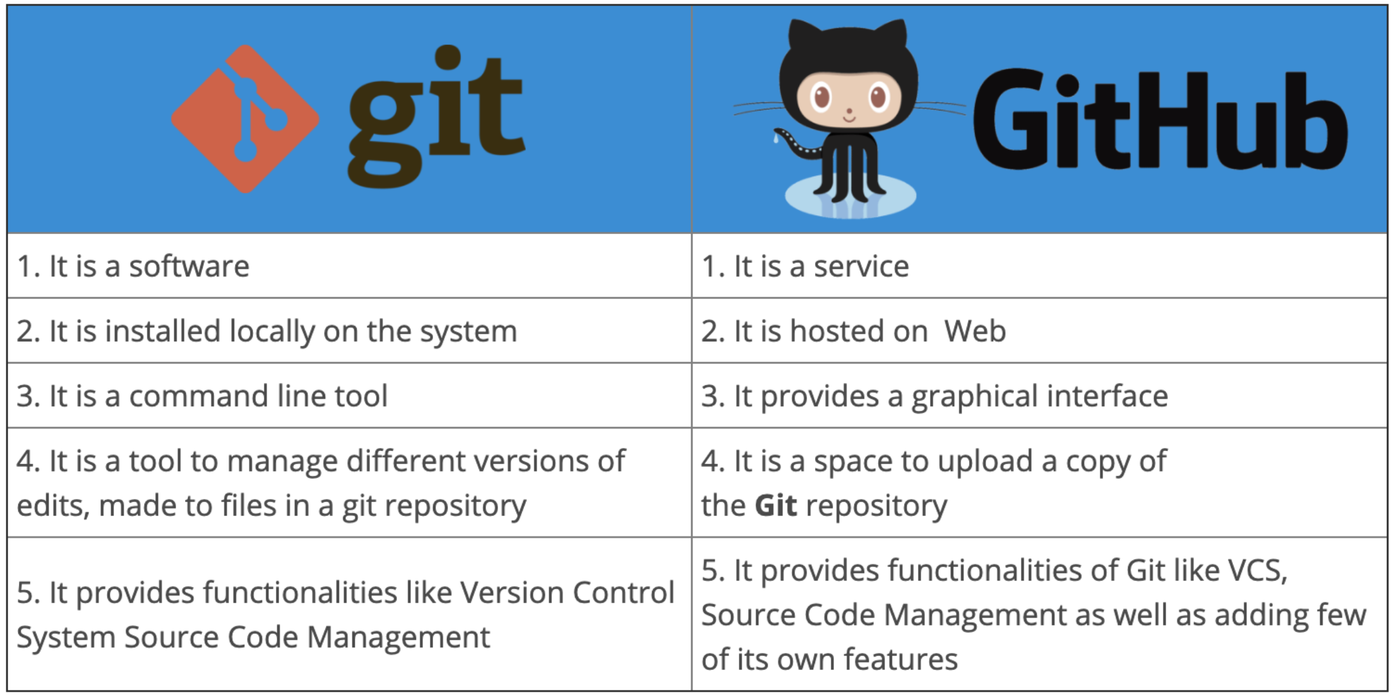
Git vs GitHub

Slide 5
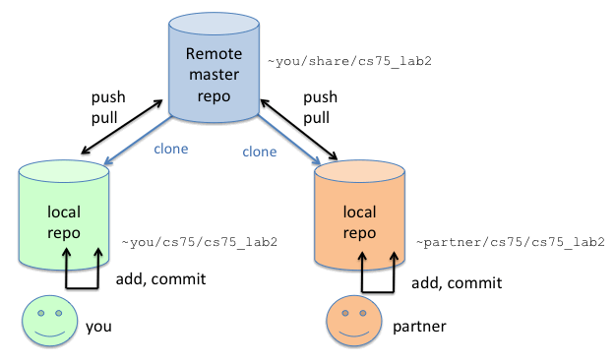
What is a Git Repository?
A Git repository tracks and saves the history of all changes made to the files in a Git project.

Slide 6
Git command
git init - Initializes a new Git repository in your current directory.
git branch <branch-name> - Create a branch in the local repository.
git checkout <branch-name> - Switches to the specified branch.

Slide 7
Git Push
git add - Stages a file or changes for commit.
git commit -m "<commit-message>" - Commits the staged changes with a descriptive message.
git push - Used to push the local repository content to a remote repository.

Slide 8
Git clone
The git clone command is used to create a local working copy of an existing remote repository.
The command downloads the remote repository to the computer. It is equivalent to the Git init command when working with a remote repository.
git clone <remote URL>

Slide 9
Git Pull
The git pull command is used to fetch and merge changes from the remote repository to the local repository.
The command "git pull origin master" copies all the files from the master branch of the remote repository to the local repository
Git pull = git fetch + git merge

Slide 10
What is a Git Merge Conflict?
A merge conflict is an event that takes place when Git is unable to automatically resolve differences in code between two commits.
Git can merge the changes automatically only if the commits are on different lines or branches.
To prevent such conflicts, developers work in separate isolated branches. The Git merge command combines separate branches and resolves any conflicting edits.

Slide 11
Git workflow, branches
Master: Once the QA is satisfied with the quality, the release branch is merged into master. This is then what is used by the customers.
Develop: A develop branch is created from main. Feature and bugfix branches are created from develop.
Feature: All features/new functions/major refactoring should be done in feature branches, which branch off of and are merged back into the develop branch.
Bugfix: The topic branches created off the release branch to deal with issues are known as bugfix branches. Gitflow bugfix branches only interact with the release branch.
Release: When enough features have accumulated or the next release time frame comes near, a new release branch is branched off of develop, which is solely dedicated to testing/bug fixing and any cleanup necessary (e.g. changing some path names, different default values for instrumentation etc.).
Hotfix: If a major problem is found after release, the fix is developed in a hotfix branch, that is branched off of the master. Those are the only branches that will ever branch off of master.

Slide 12
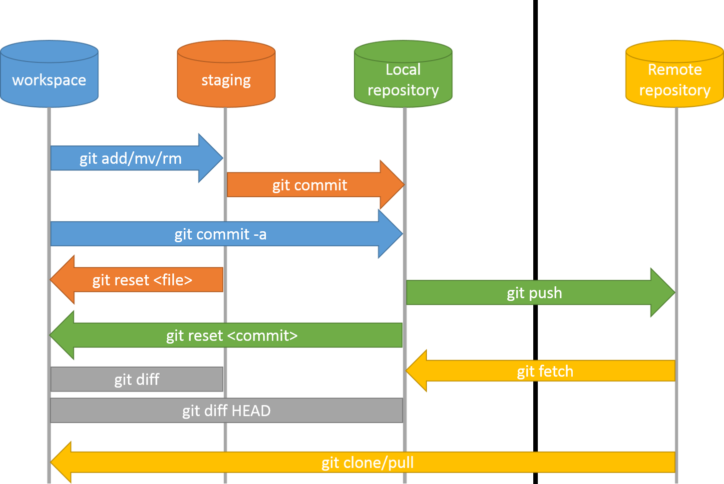

Slide 13


